Slide 1



WEATHER STATION : CENTRAL
FRIES Léo L3 ME
EL KHAYDER Zakaria L3 SE
OUFASKI Nouhaila L3 SE
2022 / 2023

Slide 2
SUMMARY
Specifications
Quick Overview
Deep Dive
Website
Central
Nodes
Housing
Real life applications
What did we learn ?
WEATHER STATION : CENTRAL FRIES EL KHAYDER OUFASKI
2

Slide 3



SPECIFICATIONS
Data Visualisation
Low Power
Web interface and/or LCD Display
Can run on battery for long periods
Long Range
Rigidity
Covering wide surrounding area
Handle the difficult weather conditions
WEATHER STATION : CENTRAL FRIES EL KHAYDER OUFASKI
3

Slide 4
QUICK OVERVIEW
WEATHER STATION : CENTRAL FRIES EL KHAYDER OUFASKI
4

Slide 5
DEEP DIVE
WEATHER STATION : CENTRAL FRIES EL KHAYDER OUFASKI
5

Slide 6
WEBSITE
Geolocation
Weather
Sunrise and sunset
Weather forecast
Nodes data visualisation
WEATHER STATION : CENTRAL FRIES EL KHAYDER OUFASKI
6

Slide 7
DATA SERIALISATION
CSV (Comma-seperated values)
JSON (JavaScript Object Notation)
{
"node": "Bedroom",
"measure": "Temperature",
"value": 25.30,
"date": "2023-04-10T23:13:22.000Z“
}
Bedroom,Temperature,25.3,1681168402
Bedroom,Temperature,9.02,1683082476
Bedroom,Temperature,1.40,1680957947
Bedroom,Temperature,4.38,1682126907
Unix Timestamp
WEATHER STATION : CENTRAL FRIES EL KHAYDER OUFASKI
7

Slide 8


APIs
{
"address": {
"city": "Strasbourg",
"county": "Bas-Rhin",
"state": "Grand Est",
...
},
...
}
{
"lat": 48.584652,
"lon": 7.762641
}
HTTP
HTTP
geocode.maps.co
8
WEATHER STATION : CENTRAL FRIES EL KHAYDER OUFASKI
6

Slide 9



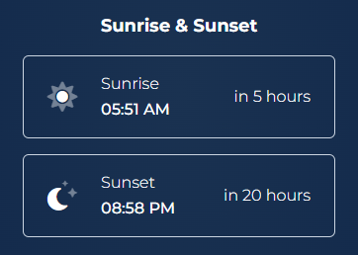
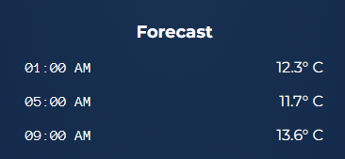
APIs
open-meteo.com
sunrise-sunset.org
9

Slide 10
DATA VISUALISATION
Input
const data = fetch('/api/db').then(x => x.text())
Line Feed (LF) = 0x0A
Output
"Bedroom,Temperature,25.3,1681168402\nBedroom,Temperature,9.02,1683082476\nBedroom,Temperature,1.40,1680957947\nBedroom,Temperature,4.38,1682126907"
WEATHER STATION : CENTRAL FRIES EL KHAYDER OUFASKI
10

Slide 11
DATA VISUALISATION
Input
data
.map((x) => x.split("\n"))
[
"Bedroom,Temperature,25.3,1681168402",
"Bedroom,Temperature,9.02,1683082476",
"Bedroom,Temperature,1.40,1680957947",
"Bedroom,Temperature,4.38,1682126907",
]
Output
WEATHER STATION : CENTRAL FRIES EL KHAYDER OUFASKI
11

Slide 12
DATA VISUALISATION
data
.map((x) => x.split("\n"))
.map((x) => {
const [node, measure, value, date] = x.split(",");
return { node, measure, value: +value, date: new Date(+date * 1000) };
});
Input
[
{node: 'Bedroom', measure: 'Temperature', value: 25.3, date: …},
{node: 'Bedroom', measure: 'Temperature', value: 9.02, date: …},
{node: 'Bedroom', measure: 'Temperature', value: 1.40, date: …},
{node: 'Bedroom', measure: 'Temperature', value: 4.38, date: …}
]
Output
WEATHER STATION : CENTRAL FRIES EL KHAYDER OUFASKI
12

Slide 13
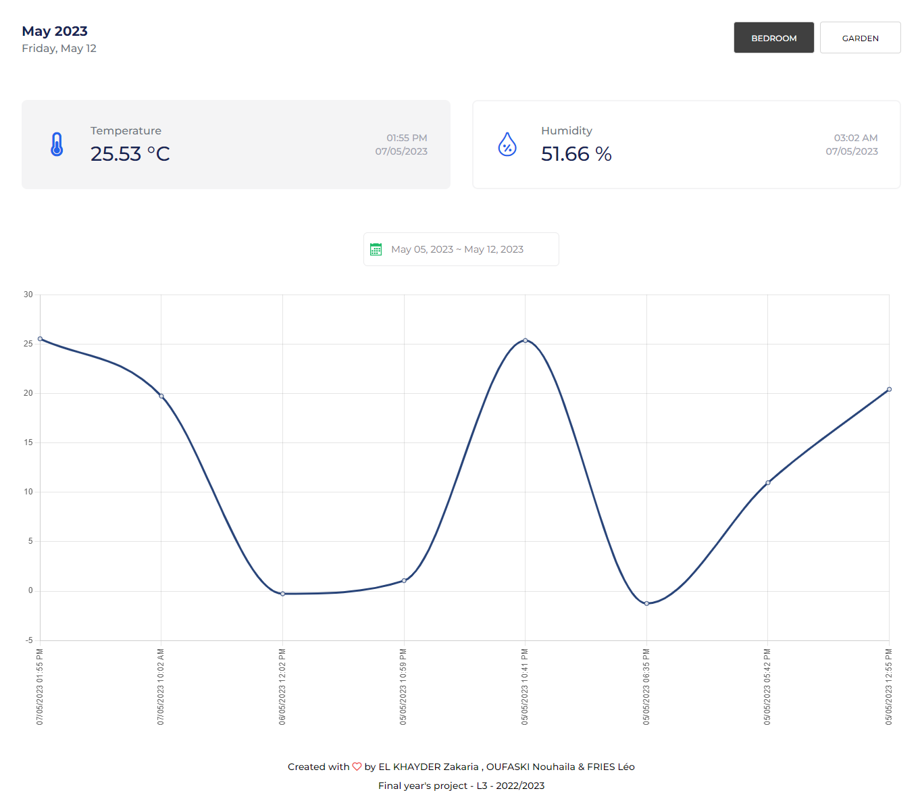
DATA VISUALISATION
Nodes
Latest measure
WEATHER STATION : CENTRAL FRIES EL KHAYDER OUFASKI
13

Slide 14
DATA VISUALISATION
14

Slide 15
CENTRAL
WEATHER STATION : CENTRAL FRIES EL KHAYDER OUFASKI
15
4

Slide 16
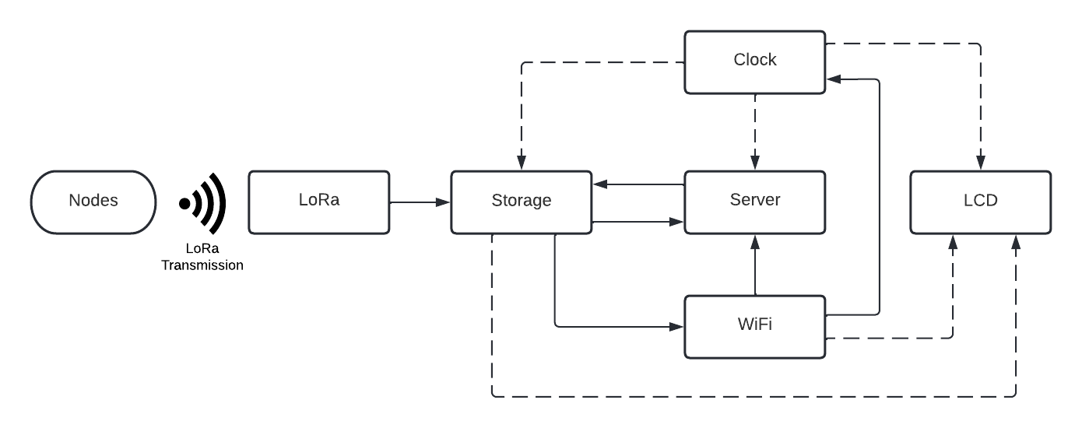
ARCHITECTURE
WEATHER STATION : CENTRAL FRIES EL KHAYDER OUFASKI
16

Slide 17
WIFI
WEATHER STATION : CENTRAL FRIES EL KHAYDER OUFASKI
17

Slide 18
CLOCK
WEATHER STATION : CENTRAL FRIES EL KHAYDER OUFASKI
18

Slide 19
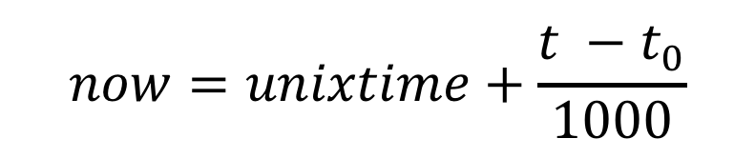
CLOCK
$$now=unixtime+\frac{t −t_{0}}{1000}$$
WEATHER STATION : CENTRAL FRIES EL KHAYDER OUFASKI
19

Slide 20
LoRa
WEATHER STATION : CENTRAL FRIES EL KHAYDER OUFASKI
20

Slide 21
LoRa
{"node":"Bedroom","measure":"Temperature","value": 25.30}\n
Bedroom,Temperature,25.30
Bedroom,Temperature,25.30,1681168402
WEATHER STATION : CENTRAL FRIES EL KHAYDER OUFASKI
21

Slide 22
SERVER
WEATHER STATION : CENTRAL FRIES EL KHAYDER OUFASKI
22

Slide 23
LCD
WEATHER STATION : CENTRAL FRIES EL KHAYDER OUFASKI
23

Slide 24
NODES
WEATHER STATION : CENTRAL FRIES EL KHAYDER OUFASKI
24

Slide 25
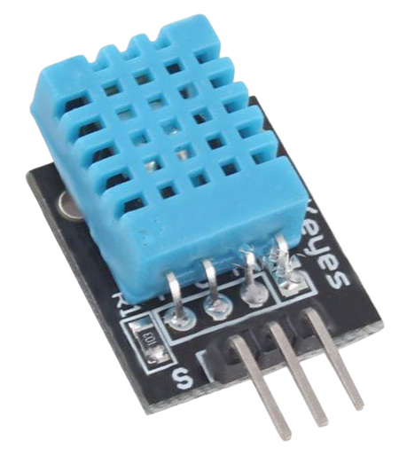
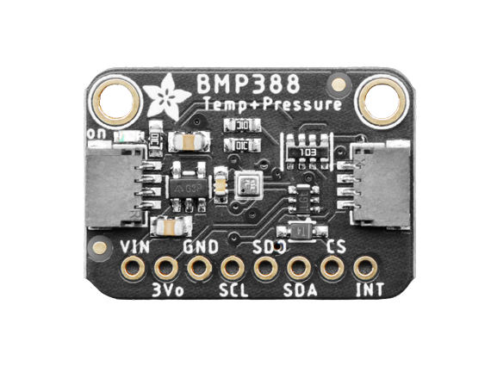
SENSORS
DHT11
BMP388
WEATHER STATION : CENTRAL FRIES EL KHAYDER OUFASKI
25

Slide 26
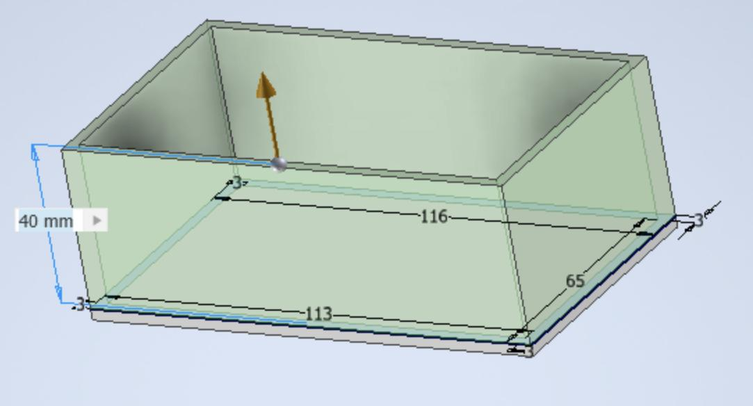
HOUSING
Protect the components
Design
Integration
WEATHER STATION : CENTRAL FRIES EL KHAYDER OUFASKI
26
23

Slide 27
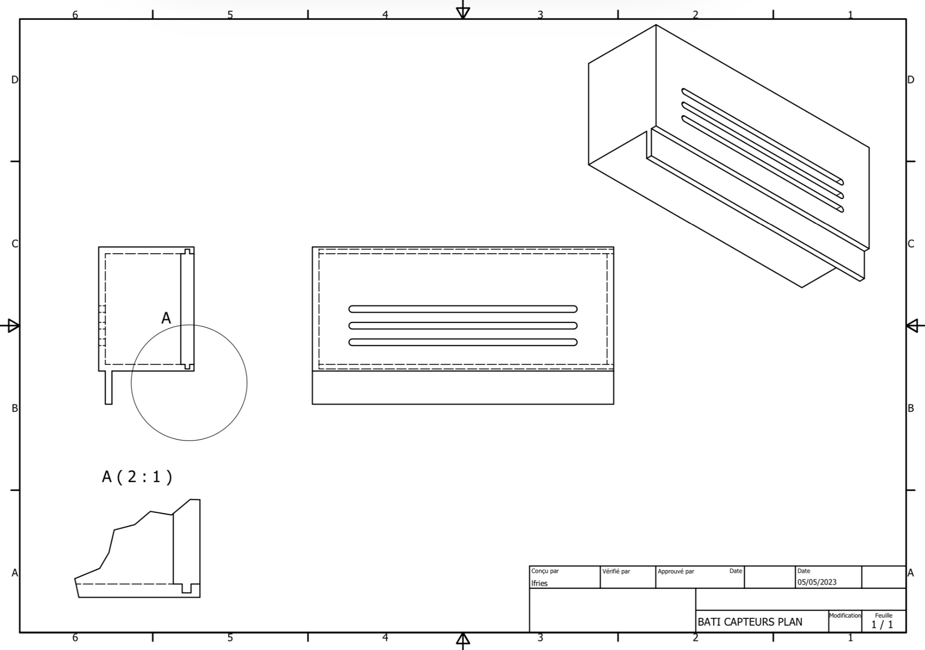
NODES BOX
Enough space for the components
A place for the antenna
Let the air flow
WEATHER STATION : CENTRAL FRIES EL KHAYDER OUFASKI
27

Slide 28
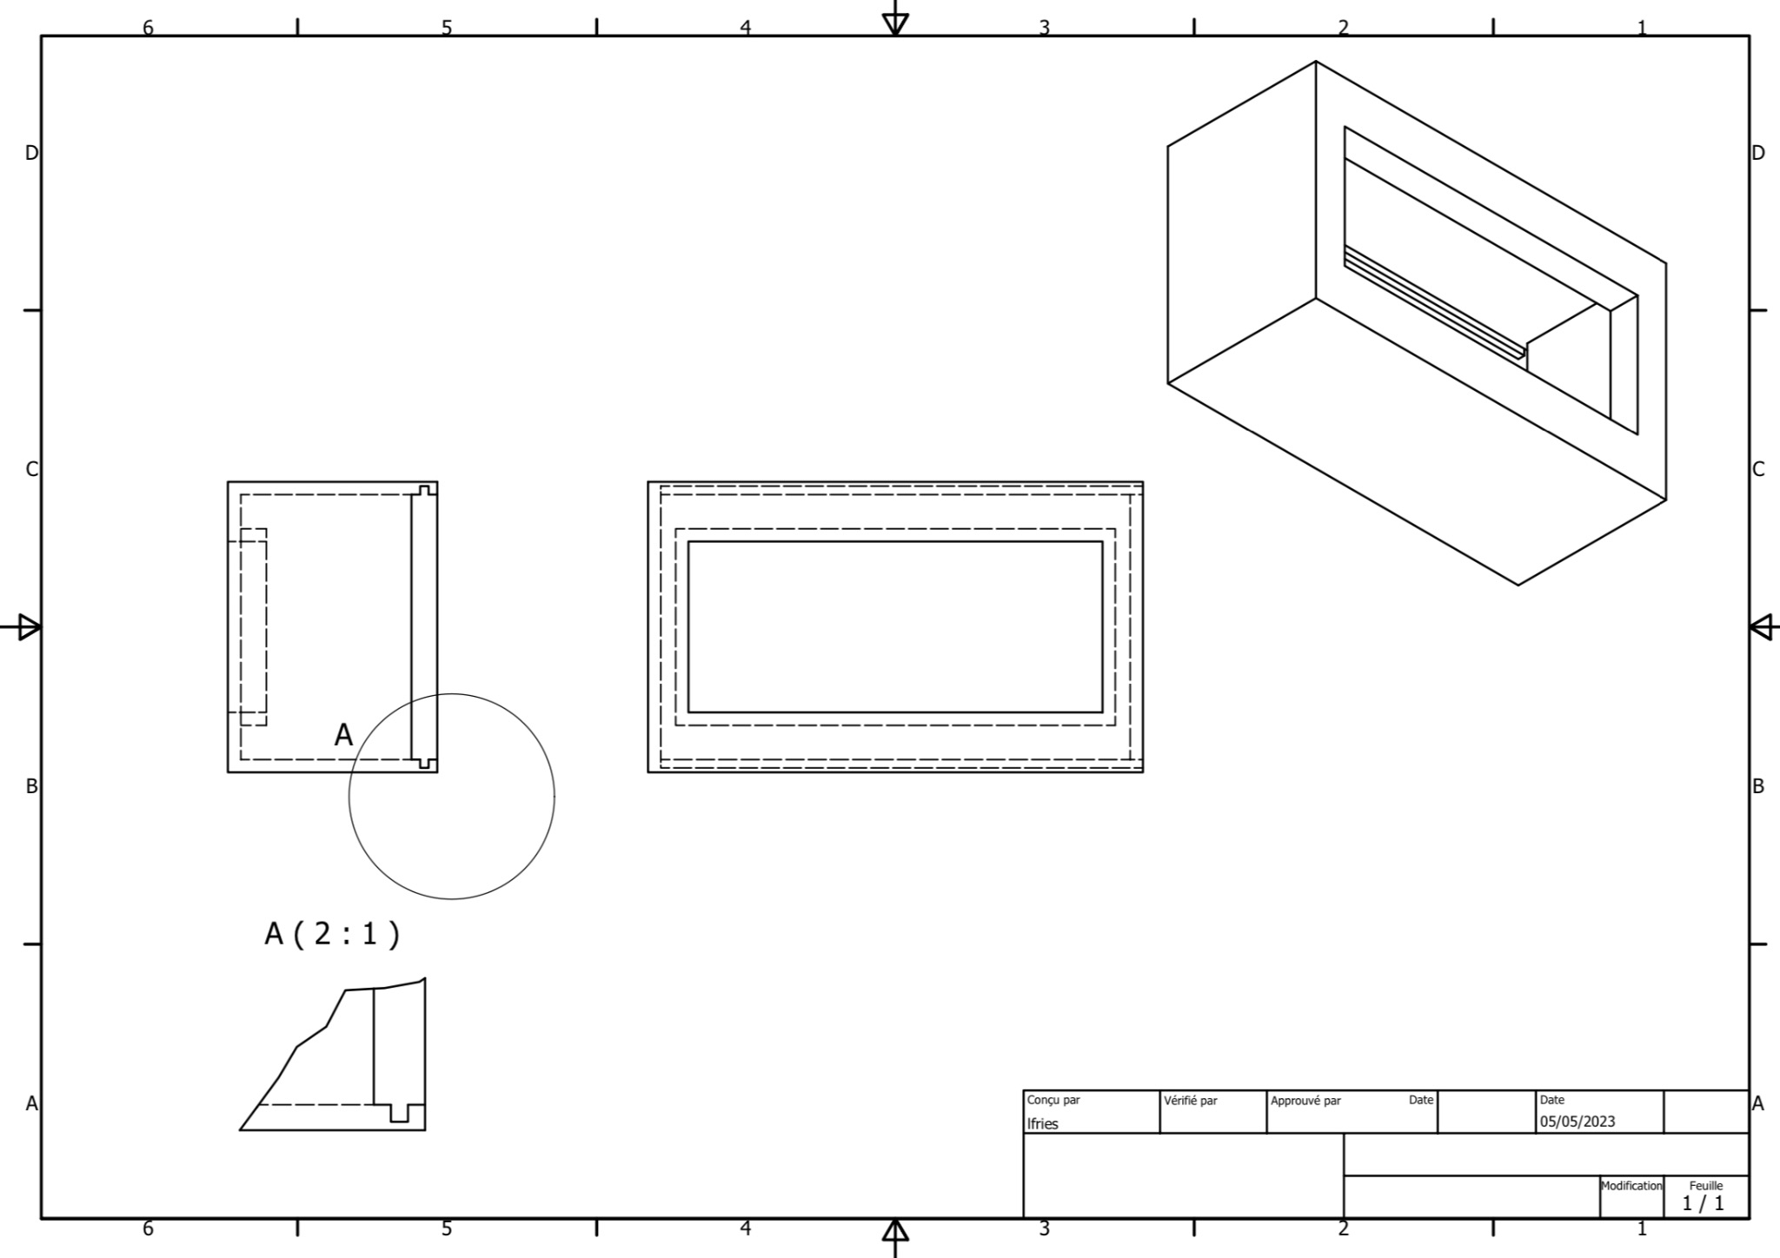
CENTRAL BOX
Space for the components and the screen
Integrate the screen cleanly to the box
Different possibilities of placement
WEATHER STATION : CENTRAL FRIES EL KHAYDER OUFASKI
28

Slide 29
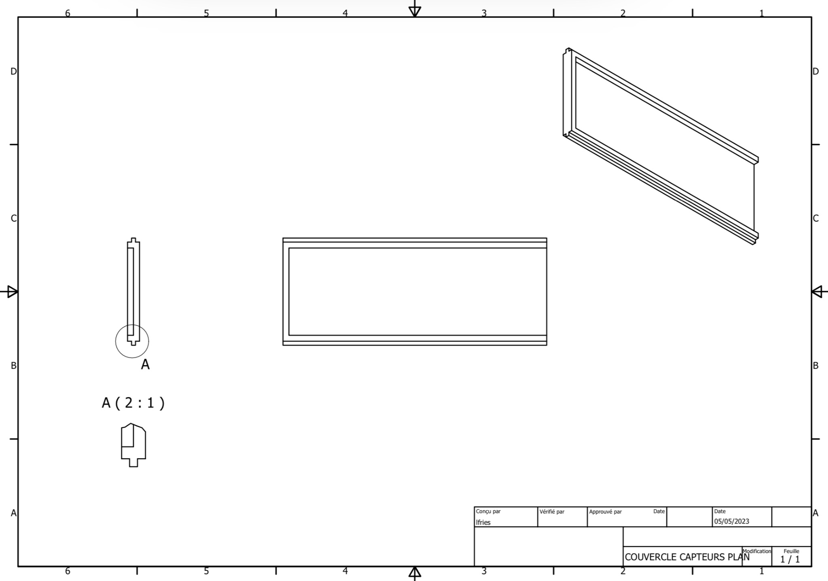
LID OF BOXES
1st try —> Fail
Slides in the box
2nd try —> Succes
Fits in the box
WEATHER STATION : CENTRAL FRIES EL KHAYDER OUFASKI
29

Slide 30
REAL LIFE APPLICATIONS
Domestic use
Gardening, Sport,
Professional use
Factories, Outside jobs
WEATHER STATION : CENTRAL FRIES EL KHAYDER OUFASKI
30

Slide 31
WHAT DID WE LEARN ?
New technologies
Team work
Experience
WEATHER STATION : CENTRAL FRIES EL KHAYDER OUFASKI
31

Slide 32
Thank you for your attention
WEATHER STATION : CENTRAL FRIES EL KHAYDER OUFASKI
32

